Slide 1
2022-23 Budget Adoption
Christopher Clapper – Superintendent
Brianne Kirchoff – Business Administrator

Slide 2
The Numbers
2021-22 Voter Approved Budget
$14,231,186
2022-23 Proposed Budget
$15,030,670
$799,484 increase
5.62% over 2021-22 expenditures

Slide 3
Top 5 increases
Instructional Salaries
$256,642
Employee Benefits
$181,235
Construction Management
$160,374
Non Instructional Salaries
$135,449
Debt Payments
$65,354

Slide 4
Breakdown: instructional salaries: $256,642
PIVOT Replaced Counselor $56,815
Dedicated elementary science teacher $48,551
High School Summer School $15,000
Creation of 12:1:1 Program $22,002
Bringing back 2 students @ current cost of $98,318
1 additional student for next year @ cost of $100,000
Savings = $178,000
3.30% Contractual Increase $111,093
Notes:
PIVOT Replacement = Katie Durand
Brian Hudon’s replacement = Andrea Mitchell
Total above = $253,461

Slide 5
Breakdown: employee benefits: $181,235
Employees Retirement
18.3% through January 2023
13.1% effective February 2023
$24,792
Teachers Retirement
Increase 9.80 → 10.29%
$51,883
Social Security
7.65% of salaries
$32,633
Health Insurance
7% increase
$56,002
Legacy costs
Includes Medicare reimbursements
Increase from $148.50 to $170.10 for most retirees
7.49% of total budget
Higher than state average of 5%
BoCES Services
Admin Fees for Health/Work Comp
OPEB Audit Fees
$15,385
Notes:
Total above = $180,695

Slide 6
Breakdown: construction management
C&S Engineers
Budgeted in general fund to allow for additional work in the overall gym project
$160,374

Slide 7
Breakdown: non instr’l salaries: $135,449
Transportation Contractual Changes $29,632
Extra runs paid at hourly rate
Sign on Bonus
Full Time Bus Driver Trainer $21,569
Includes $4k health ins buyout previously in cafe
Self Sustaining Program
Full Time Mechanic’s Helper $48,748
Replaced an existing position
3.25% Contractual Increase $36,666
Notes:
Total above = $136,615

Slide 8
Breakdown: debt payments: $65,354
2021-22 Bus Bonding
Year 3 of 5 year plan
$62,164
Final EPC Payment
Expiring project
Decrease $60,014
2022-23 BAN Interest on Gym Project
$62,500
Offset by expiring EPC Payment – no add’l costs to taxpayers

Slide 9
What about decreases?
Maintenance Equipment
$18,700
Sound System Upgrades
$18,000
Cardio Room
$26,000
Line by Line cuts throughout budget planning process
$140,000
$320,000
BOCES Special Education
$11,079
BOCES CTE Program
$9,338
Student Telemedicine
$10,000
Transportation Equipment
$51,000
Baseball Field
$40,000
Notes:
Total above = $324,117

Slide 10
Where did the decreases go in the budget?
Transfer to School Lunch Fund
$25,000
Legal Fees
$15,000
Building Maintenance & Utilities
$40,000
College Tuition
$15,000
Garage Concrete Work
$35,000
Scoreboard
$10,000
BOCES PD
$20,000
Instructional & Student Supplies
$35,000

Slide 11
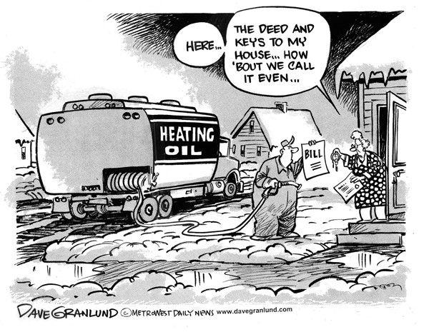
Flashback: Fuel, Gas
Heating Oil – Main Building
$1.8331 → $2.6065 = 42.19%
Heating Oil – Garage
$2.1990 → $2.8910 = 31.47%
Diesel
$2.2980 → $3.0871 = 34.34%
Gasoline
30–40% Increase as per Fin’l Advisors

Slide 12
Flashback: electricity
102.45% increase
Solar Refund:
2020 = $1,087.48
2021 = $1,425.32
On track for highest revenue to date for 2022

Slide 13
Flashback: food
Millers Meat Market = 22.57%
USDA Supplement Expected to End June 30
Increase in Supplement from General Fund
$75,000 → $100,000

Slide 14
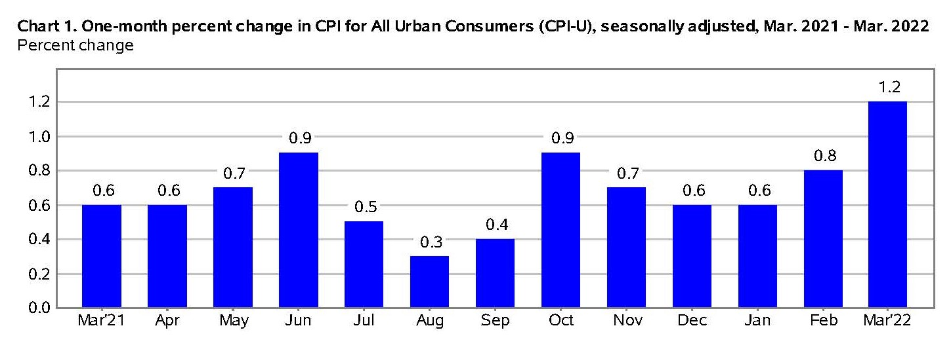
Updated inflation figures
Source: Bureau of Labor Statistics
Notes:
March 2022 had largest one month inflation increase

Slide 15
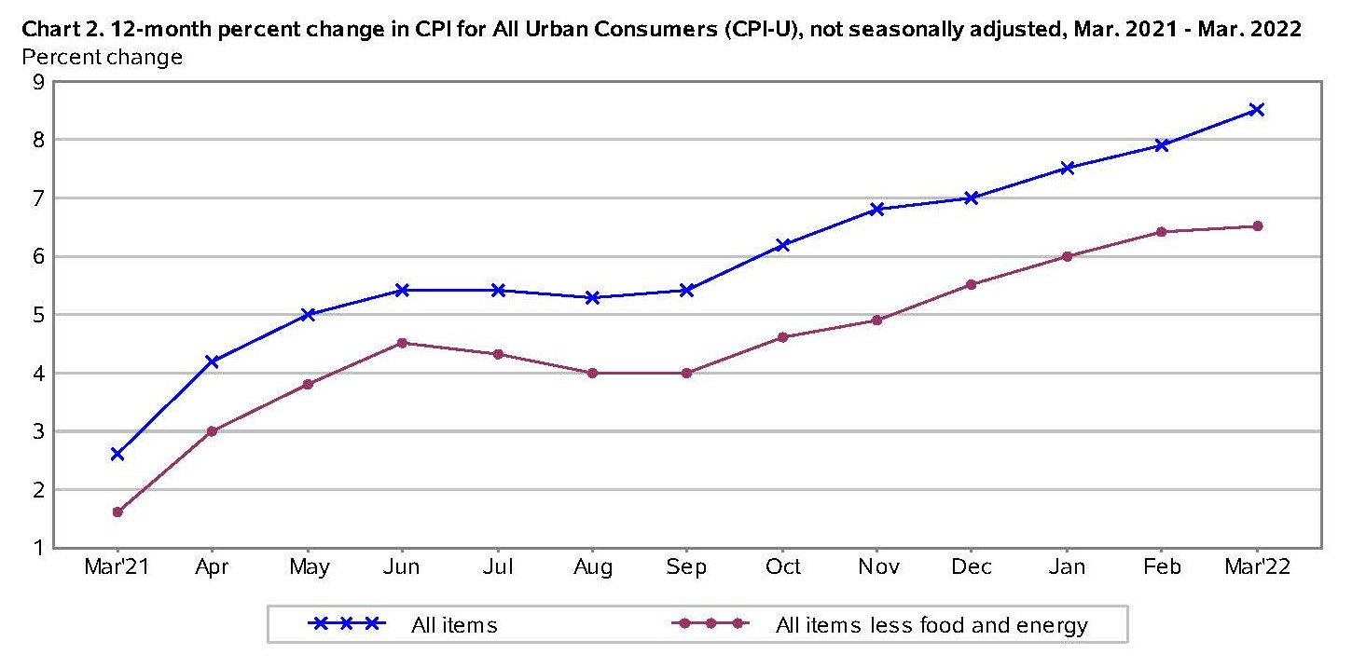
Updated inflation figures
Source: Bureau of Labor Statistics
Notes:
March 2022 had largest one month inflation increase

Slide 16
3 Part budget
Administration | $ 1,542,356 | $ 1,613,495 | $ 71,139 | 4.61%
Program | $ 10,263,367 | $ 10,736,349 | $ 472,982 | 4.61%
Capital | $ 2,425,463 | $ 2,680,826 | $ 255,363 | 10.53%
 | $ 14,231,186 | $ 15,030,670 | $ 799,484 | 5.62%

Slide 17
3 Part budget: administration
HS Secretary was reinstated in 2021-22
A change from 2020-21
Administration | $ 1,542,356 | $ 1,613,495 | $ 71,139 | 4.61%
Notes:
Meredith Graveline moved to HS secretary. With benefits, cost increase $69k

Slide 18
3 Part budget: program
Contractual Increases in Salaries
Summer School
Substitute Salaries
Professional Development
Special Education TA
Bus Driver Trainer
Mechanic’s Helper
Program | $ 10,263,367 | $ 10,736,349 | $ 472,982 | 4.61%
Notes:
3.30% increase for instructional
3.25% non instructional
PD through boces (Julie White)
Lisa Willix
Ethan Phelps

Slide 19
3 Part budget: capital
Capital Project Management
School Resource Officer (reclassified from Program in prior year)
Debt Service
Capital | $ 2,425,463 | $ 2,680,826 | $ 255,363 | 10.53%
Notes:
$160k for C&S
$51k SRO
$65k debt payments

Slide 20
Funding: local sources
New sources of revenue
Hammond CSD
Transportation Agreement - $24,000
Business Office Agreement - $85,000
Village of Alexandria Bay
Fueling Station Agreement – $24,000

Slide 21
Funding: state sources
Foundation Aid Increase – 3%
$110,000
Building Aid
Decreased $42,630
Based on capital projects
EPC project completed
Gym project will keep aid coming
Transportation Aid
Decreased $57,031
Based on estimates by Governor
Amounts are never accurate, district must be conservative
District used current year actual aid for estimate
Total Net State Aid Increase = $26,235 = .50%
District is forced to rely more on property taxes to balance budget

Slide 22
Definition: The Combined Wealth Ratio (CWR) is defined by New York State as a “…measure of a district’s wealth taking into account both the district’s real property [values] and the income of residents of the district” (NYSED, 2017).

Slide 23
Prior Year’s charts
A Bay INCREASED in value
Lyme & TI Decreased
LaFargeville stable

Slide 24
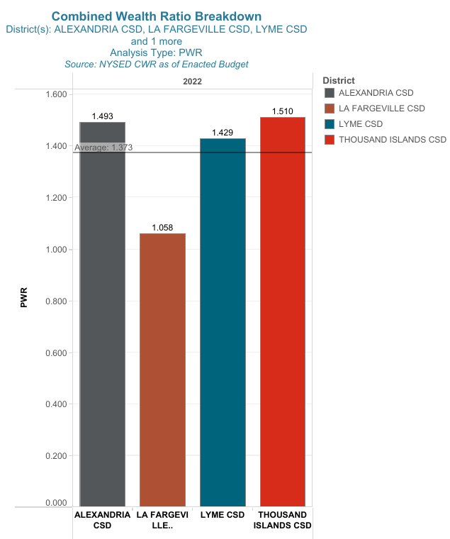
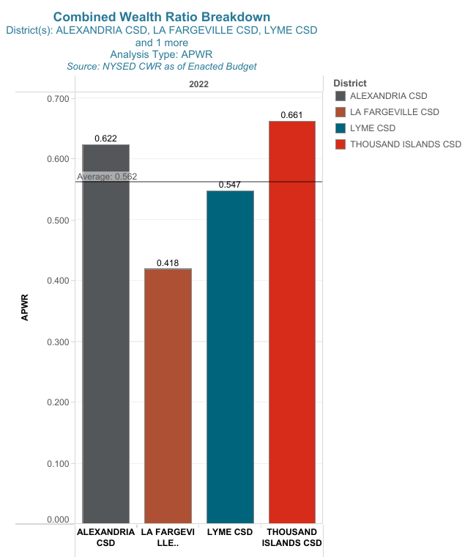

Slide 25
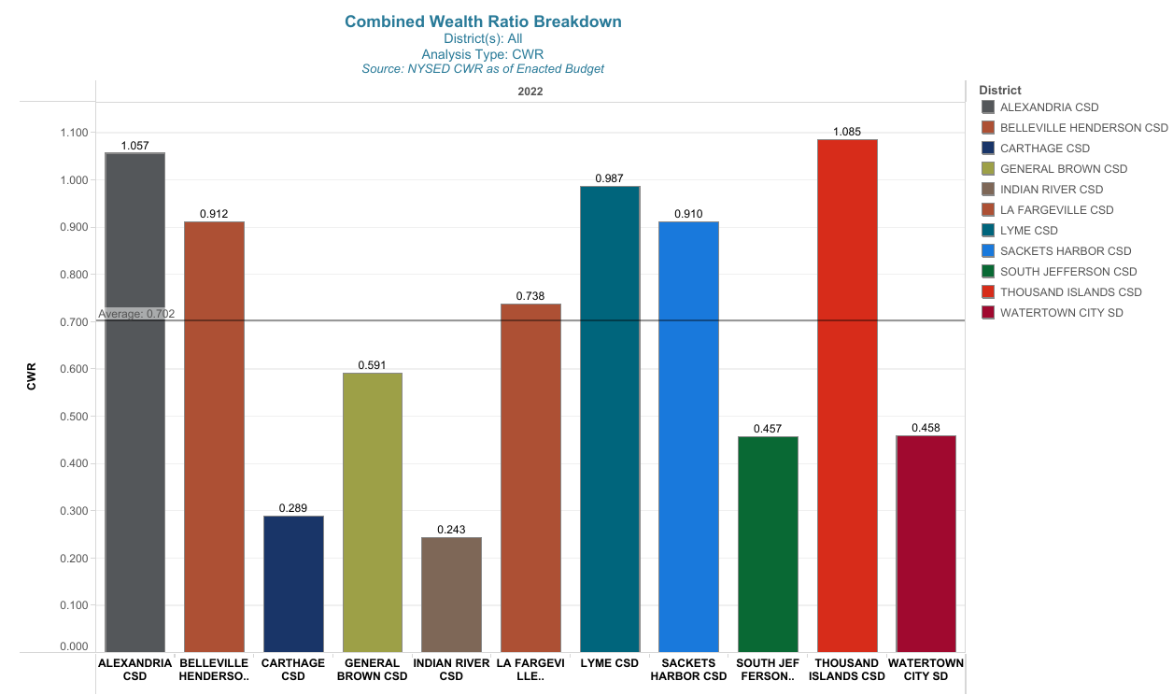

Slide 27
Funding: federal sources
ARPA Funding
$60,800
Funds allocated to learning loss salaries
Summer School
Ghost Academy
Expenses are reoccurring
Must remain in General Fund budget for future years

Slide 28
Funding: arpa (cont’d)
Top 5 Spending Areas:
20% Learning Loss $180,400
Floor Renovations (Dick Tile) $109,950
Baseball Field Renovations $106,195
Air Conditioning & Wiring $112,093
Jr High Wing Flooring/Carpet $40,000 (estimate)
Notes:
Top 5 places we are using ARPA

Slide 29
Funding: fund balance & tax levy
Appropriated Fund Balance
$1,350,000
Currently keeps Unappropriated Fund Balance at 12%
Tax Levy to Balance Budget = 3.90%
$306,514
Below Tax Cap of 3.95%
1% increase in tax levy = $78,593
Becomes base of tax levy extrapolated over time

Slide 30
Tax levy impact
 | Property Assessment Value
 | $50,000 | $100,000 | $150,000 | $200,000
1.0% | $6.48 | $12.97 | $19.45 | $25.93
2.0% | $12.97 | $25.93 | $38.90 | $51.87
3.0% | $19.45 | $38.90 | $58.35 | $77.80
3.9% | $25.28 | $50.57 | $75.85 | $101.14

